Slide 1
HYBRID BOOK RECOMMENDATION SYSTEM
Combining AI Algorithms for Personalized Suggestions
BY: UDITA CHUTANI- 102303581
RAGHAV CHHABRA- 102303580
MANAN PAREEK- 102303570
SUBGROUP : 2C42

Slide 2
ABSTRACT
Hybrid system integrating content-based, collaborative filtering, and graph-based techniques.
Uses TF-IDF, SVD, and A algorithm* for diverse recommendations.
Goals:
Improve recommendation accuracy.
Address cold-start problem.
Enhance user experience with personalized suggestions.
00

Slide 3
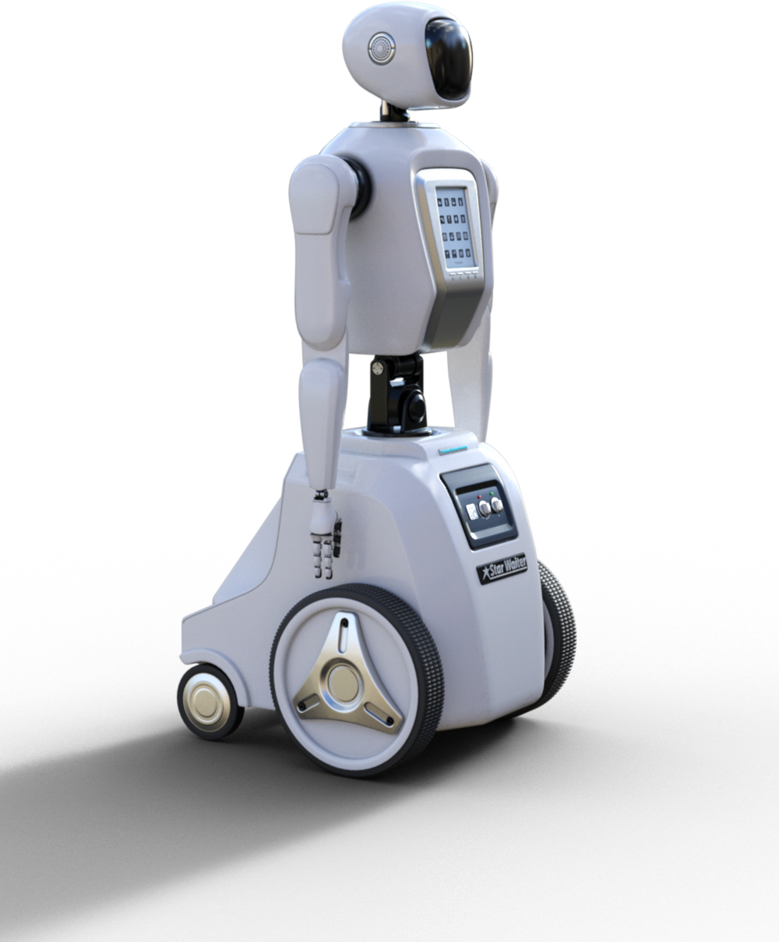
01
INTRODUCTION
Problem Statement:
Overwhelming book choices lead to decision fatigue.
Traditional systems lack personalization or fail with sparse data.
Solution:
Hybrid model balances user preferences and book attributes.
Targets niche genres and diverse reader interests.

Slide 4

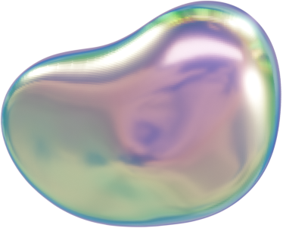
02
METHODOLOGY
Pipeline Overview:
Data Collection: Goodreads-10k dataset (books, ratings, tags).
Content-Based Filtering:
TF-IDF + Cosine Similarity (title, authors).
Collaborative Filtering:
SVD for user-book matrix factorization.
Graph-Based:
A* algorithm on book similarity graphs.
Hybrid Model: Weighted combination of all approaches.

Slide 5
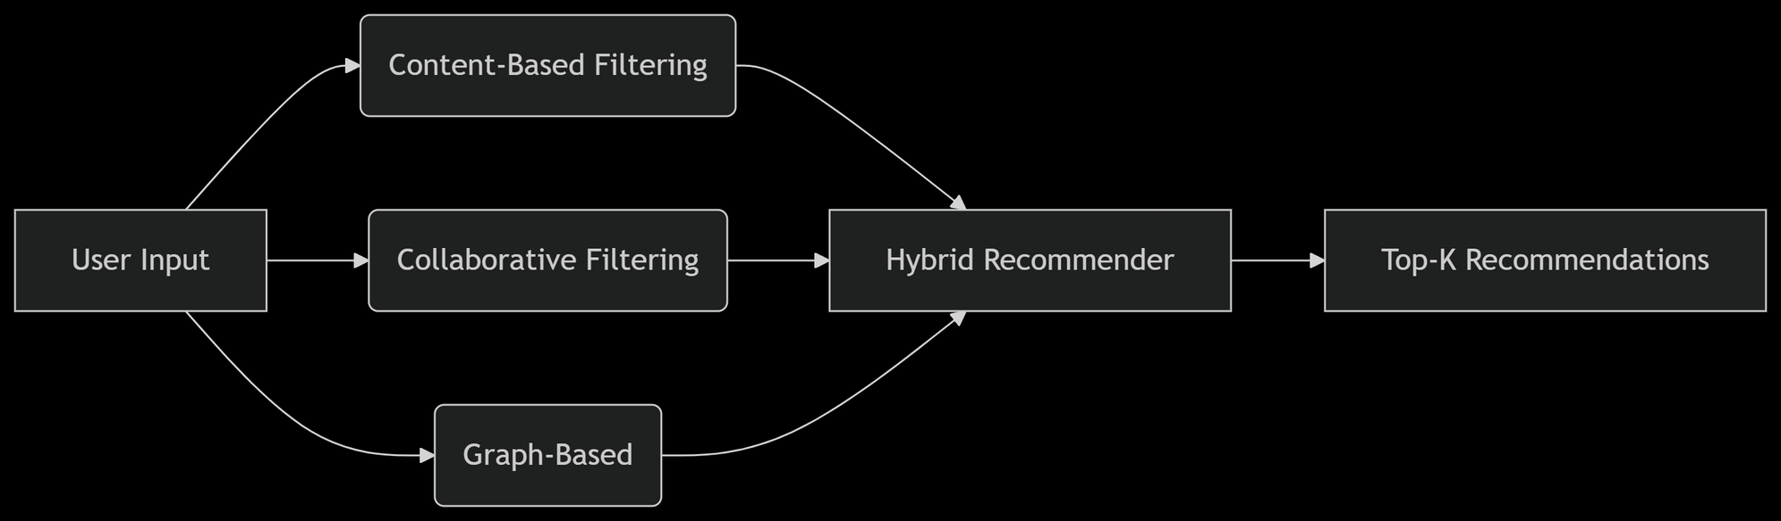

02
THYNK
UNLIMITED
METHODOLOGY

Slide 6
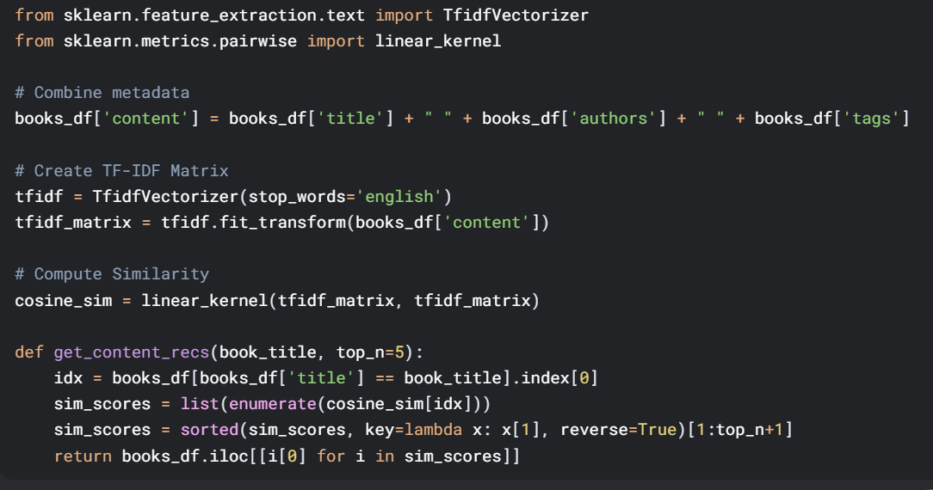
03
1. CONTENT-BASED FILTERING (TF-IDF + COSINE SIMILARITY)
KEY INSIGHT:
USES BOOK METADATA (TITLE, AUTHORS, TAGS) TO FIND SIMILAR ITEMS
TF-IDF WEIGHTS RARE WORDS HIGHER THAN COMMON ONES

Slide 7
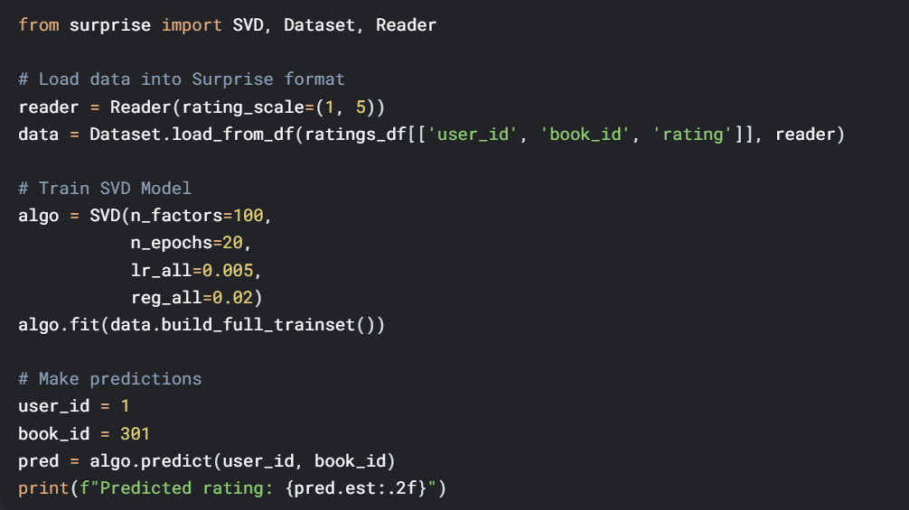
03
2. COLLABORATIVE FILTERING (SVD)
MATRIX FACTORIZATION:
DECOMPOSES USER-BOOK MATRIX INTO LATENT FACTORS
FACTORS REPRESENT ABSTRACT FEATURES LIKE "GENRE PREFERENCE" OR "WRITING STYLE"

Slide 8
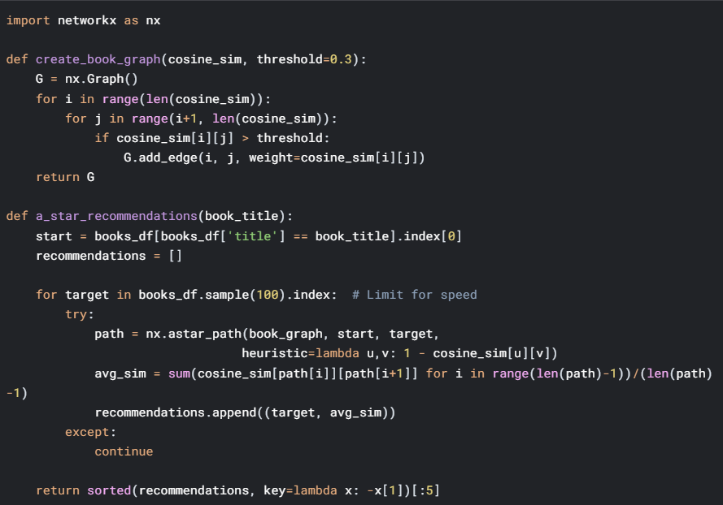
03
3. GRAPH-BASED RECOMMENDATIONS
(A* ALGORITHM)
WHY A*?
FINDS OPTIMAL PATHS THROUGH BOOK SIMILARITY GRAPHS
HEURISTIC GUIDES SEARCH TOWARD MOST RELEVANT BOOKS

Slide 9

04
HYBRID MODEL
def hybrid_recommend(user_id, book_title, content_weight=0.4, collab_weight=0.5):
# Content-based
content_recs = get_content_recs(book_title).set_index('book_id')
# Collaborative
user_ratings = ratings_df[ratings_df['user_id'] == user_id]
unread_books = books_df[~books_df['book_id'].isin(user_ratings['book_id'])]
collab_recs = []
for book_id in unread_books['book_id'].sample(100):
pred = algo.predict(user_id, book_id).est
collab_recs.append((book_id, pred))
# Combine scores
recommendations = {}
for book_id, score in content_recs['cosine_score'].items():
recommendations[book_id] = score * content_weight
for book_id, score in collab_recs:
recommendations[book_id] = recommendations.get(book_id, 0) + score * collab_weight
return sorted(recommendations.items(), key=lambda x: -x[1])[:10]

Slide 10
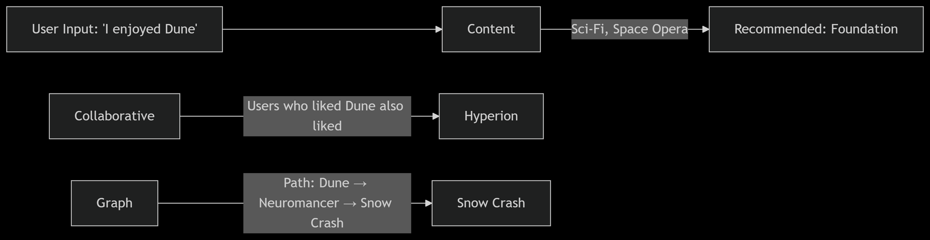

05
REAL WORLD EXAMPLE

